Slide 1
Concepts 1.5 - Architecture Design
Utkarsh Vardhan

Slide 2
Characteristics of Concept 1.5
Extensibility
To different DOC_TYPES
Flexibility
Adapt to a constantly changing environment.eg: new Business rules.
Agility
Respond quickly to a constantly changing environment.Changes can largely be isolated and implemented quickly.
Isolation of Features and Isolation of custom Extraction logic.*
Which DOC_TYPE get what features
Ease of Testability
Can be tested in isolation and can use mock objects to demonstrate or prototype a particular feature with little or no change.
High Performance
Customize and streamline the module to only include those features you need and trim down/ remove expensive non-used features.
Scalability
Ease of Development
Ease of Deployment

Slide 3
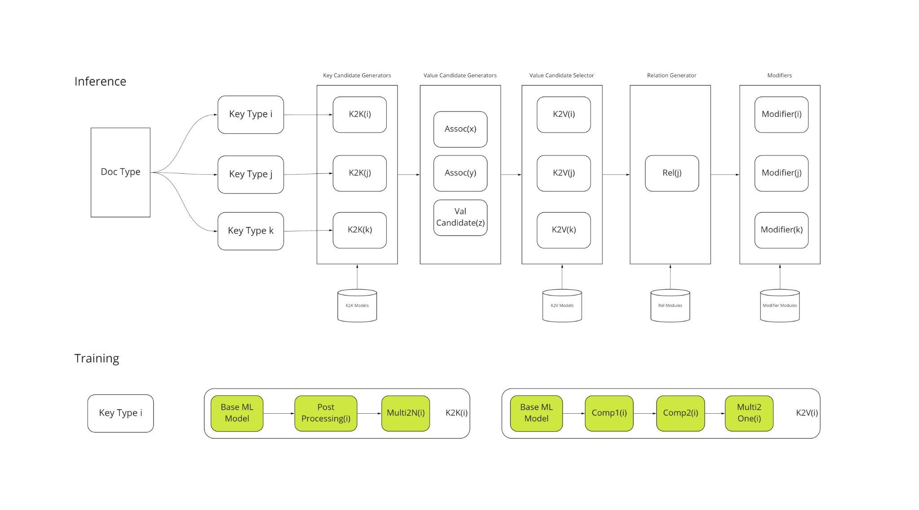
Concepts Design Flow

Slide 4
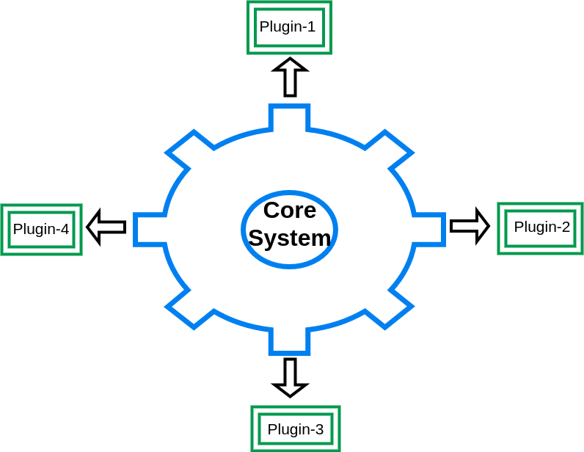
Microkernel Architecture

Slide 5
Pattern Description
Basic Core System
Minimal functionality required to make the system operational.
Plugin Modules
Stand-Alone, independent components that contain specialized processing, additional features, and custom code that is meant to enhance or extend the core system to produce additional business capabilities.
Plugin Modules can be designed in the following ways:
Independent of other plugin modules.
Requires other plugins to be present.
DOC_TYPE Configuration
Information about core system functioning and each plug-in module
Things to do: 1. Define Minimal functionality for Concepts w.r.t Business Logic or Product Specification. 2. Define Minimal functionality for Plugins.

Slide 6
Design Architecture
Core System
1. Key Anchors Collection Using K2K
2. Contextualize PRS results*
3. Candidate(Value) Generation
Using Key Anchors Candidate Generator
Using SPV
Using Reference[those not part of SPV]
4. Candidate Selection-Default Mode
5. Utility Functions. For eg;Serialisation,I/O operations
6. Input Output structure Formatter - Standard way to pack input and output values.
Relations
Candidate Selection
Using ML(K2V)
Relation Extraction
Business Driven Candidate Selection Rule
Modifier

Slide 7
Core System - Layered Architecture
Various elements of the system are categorised and have a specific place where to be, according to the category you assigned them.
Guiding Principles
Divided into multiple layers .The number of layers is defined by the complexity of the application.Most common layer stack could be:
Entity - Innermost layer
Use Case
External System
The deeper a layer is in the architecture, the more abstract the content is.
The communication between elements that live in the same layer is unrestricted,
but when we want to communicate with elements that have been assigned to other layers you have to follow some rules.

Slide 8
Entity Layer
Contains everything, the project needs to interact with.
A domain object that has long-lived identity.
They have identity equality.We can change their values,and they are still recognisably the same thing.
Inmost layer of the architecture.
Will contain classes, with methods that simplify the interaction with them.
Entities have mutual knowledge since they live in the same layer, so they interact directly.eg. One of the Classes can use another one directly, instantiating it and calling its methods.
Entities don’t know anything that lives in outer layers.
Meant to be lightweight models.

Slide 9
Use Cases Layer
Consists of the processes that happen in your application with real data.
Identify and isolate small actions that can be a part of this layer.
Use cases know the entities, so they can instantiate them directly and use them.
Complex use cases can be put together by building on simpler ones,if required.
Smaller use cases works well as this will make the whole system easier to test, understand and maintain.

Slide 10
External System
Implements the interface to provide data to the other layer.
Interface or a Wrapper to provide data from external data source. For eg: SQL Database, Mongodb, or any other Data Source Module or upstream task.
The elements in this layer are exposed by a given set of methods to be accessed by use case layers.
It has access to all the elements defined in the Entity layers that means entity models can be called and used directly from this layer.

Slide 11
Concepts Execution Flow
Input Parameters
Use Case Initialisation
Use Case Execution
Output
Get call parameters(configuration) from the User/Upstream Module.
Initialise a use case with a Repository[lw,clw,PRS] and User Configuration
Execute the use case that fetches Entity models from the repository
Pass on the output to other downstream modules.

Slide 12
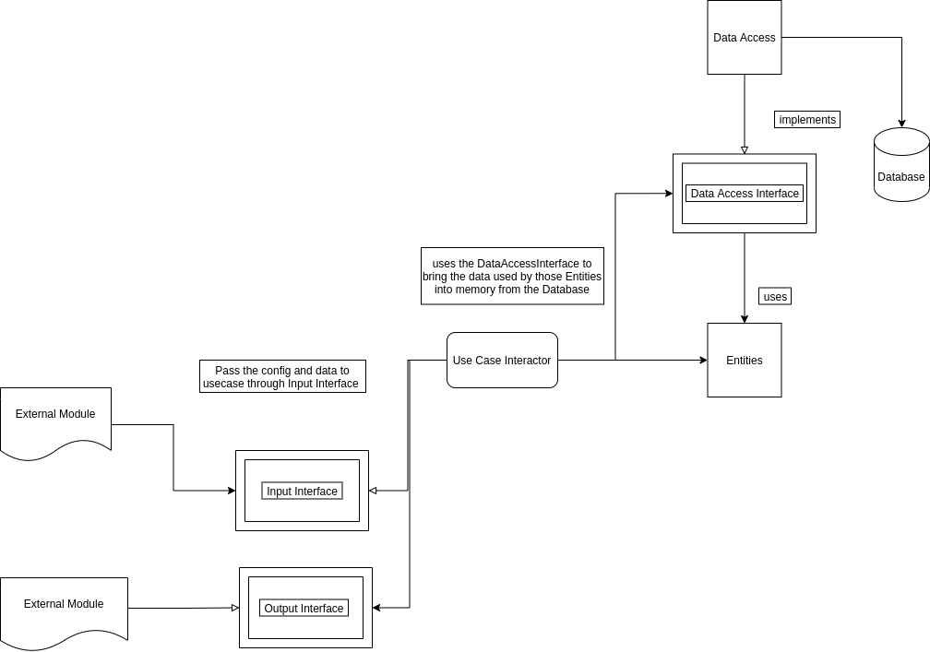
Concept Execution Scenario

Slide 13
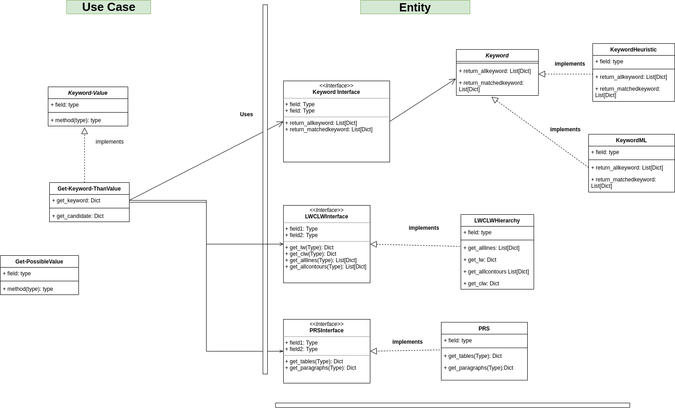
UML Diagram

Slide 14
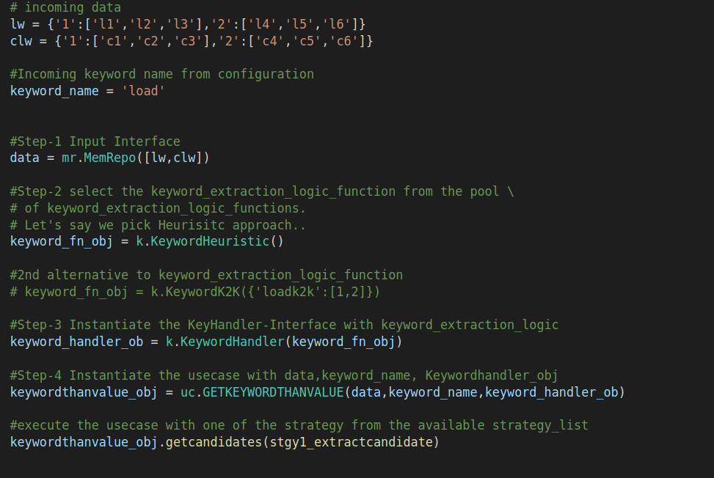
Use Case Execution Scenario

Slide 15
Links to Other Resources
List of Currently Used methodologies in the extraction process

Slide 16
Next Steps
Look at the available different use cases in Concepts.
Identify and map the module level configuration with key universe.
What are limitations of the current design?
What are possible extensions to think about for the future?
Any other considerations?
What are the developmental milestones and in what order?
Are there any potential side-effects on other areas of the application when adding this feature?
Parallel Processing [k2k+k2v]

Slide 17
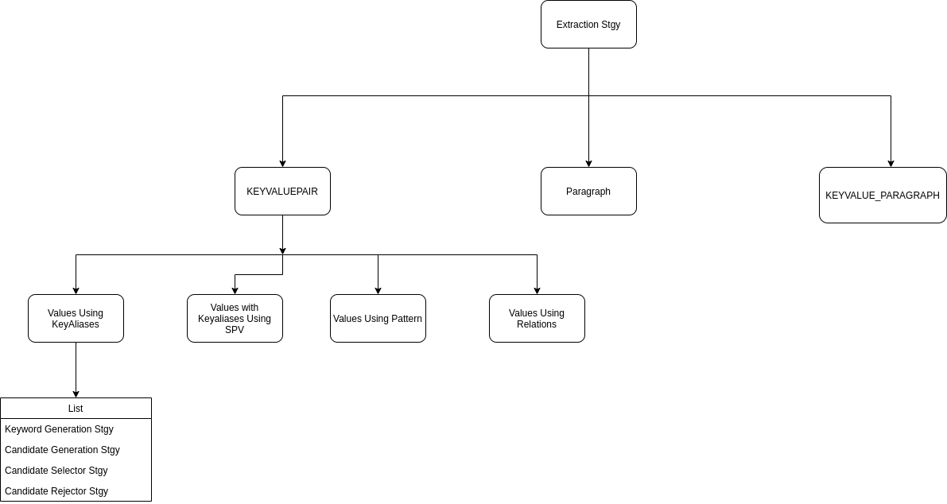

Slide 18
END

Slide 20
Error Management
To manage errors related to corner case that we left out, or a condition that we supposed could never fail, while it does.
Implemented in the Use Case Layer.

Slide 21
├── concepts
│ ├── extractor.py -- In- progress
│ ├── doc_type_config
│ │ └── coo_eng.json
│ ├── entity
│ │ └── Candidate.py
│ └── Keyword.py
│ ├── repository
│ │ ├── lw_handler.py
│ │ ├── clw_handler.py
│ ├── request_objects
│ │ └──candidate_request_object.py
│ ├── response_objects
│ │ └── response_objects.py
│ ├── serializers
│ │ └── json_serializer.py
│ │── use_cases
│ │ └──get_keyword_then_value.py
│ │── plugins
│ │ └──plugin1.py
│ └── utils
│ └──utils1.py

Slide 22
├── concepts
│ ├── extractor.py
│ ├── doc_type_config
│ │ └── coo_eng.json
│ ├── entity
│ │ └── Candidate.py
│ └── Keyword.py
│ ├── repository/data_source
│ │ ├── lw_handler.py
│ │ ├── clw_handler.py
│ ├── request_objects
│ │ └──candidate_request_object.py
│ ├── response_objects
│ │ └── response_objects.py
│ ├── serializers
│ │ └── json_serializer.py
│ │── use_cases
│ │ └──get_keyword_then_value.py
│ │── plugins
│ │ └──plugin1.py
│ └── utils
│ └──utils1.py

Slide 23
Open Questions
Does execution pipeline should be DOC_TYPE Specific or Use Case Specific.
Does DOC_TYPE Configuration will have an external interface.If yes,how do we design it.

Slide 24
Components
1. Keyword Handlers - To handle any pre/post processing required in the structure of the identified key anchors for the downstream extraction modules.
Collating key anchors of different keyword.For eg: Delivery Date and COQn Date
2. LW Handler - Any pre/post processing required for LW-hierarchy.
3. Clw Handler - Any pre/post processing required for CLW-hierarchy.
5. Candidate(Value) Generation Handler - All candidate generation logic driven through this handler
6. Reference Search Handler - SPV ,ANA based, Custom search
9. Candidate Selection Handler

Slide 25
Current Problem at Hand
General Purpose Functions has not been identified and decoupled from the documents_type specific functions.
The Granularity of the extracted results from Concepts is not configurable.
Decouple Concepts Config Key Setup from Sara Engine Key Setup.

Slide 26
UseCase1- behavior of the Use Case does not depend, in any way, on which of the two subtypes it uses.
Get Keyword
Get_k2k_results<class1>
Get_keyword_heurisitic<class2>
Get Keyword<I>
UseCase1
k2k
heuristic

Slide 27
Page Information - Height, Width
K2K,LW,CLW,Doc_TYPE Config,PRS*
Use Case - Get keywordthanvalue Get valuethan keyword, Get valueonly
Plugins -UseCase Extension - Find Date, Get Entity, MultitoSingle Line
Utilities - StringMatch.py[Output],String Found

